Slide 1
Plasmid population in Bovine Rumen – Inference Through Metagenomic Analysis
Research Project in Life Sciences
Goor Sasson ID 038229860
Open University of Israel
Performed at Mizrahi Lab, Volcani ARO
External Director: Dr. Itzhak Mizrahi
Open University Directors: Dr. Ronit Weisman & Professor Anat Barnea
September 2013

Slide 2
Abstract
An automatic bioinformatic pipeline accompanied with a special-purpose viewer application was developed, enabling the classification of metagenomic nucleotide contigs according to whether they belong to a plasmid origin, non-plasmid or as being composed of a mix of a plasmid with accessory functions.
The application was used on a metagenomic DNA data that was gathered through a plasmid-specific DNA extraction method recently developed in ARO Mizrahi lab.
The analysis made using the application presented here has shown that the vast majority of the metagenomic contigs that were assembled based on the DNA extraction bear plasmid backbone, by that proving the high reliability of the noble DNA extraction method.

Slide 3
Project Mission
Provide a bioinformatic pipeline and accompanied viewer application to identify contigs from origin content and shed light on accessory genes of interest that they might contain.
Provide a dedicated tool for the classification of metagenomic contigs, based on the description of the annotated ORFs they contain.
Provide an friendly graphical interface that would provide the ability to browse between the different contigs, sort them according to the classification they got and view ORFs classification.
Provide statistics regarding the distribution of the classification of the contigs.

Slide 4
Background & Motivation
A noble method of extraction of metagenomic DNA was developed in the lab. We wanted to confirm that the method is effectively biased towards plasmid genomes.
In the heart of the idea was the need to use plasmid specific keywords to fish Plasmid-candidate contigs from a metagenome.
The understanding that the task of classifying ORFs and contigs by the content of their BLAST description field is a generic task leading to ad-hoc scripting solutions that require programming skills, motivated us to try and build a tool that is flexible and robust enough to address the typical needs of a researcher in need for such a classification process.

Slide 5
Main Backend Workflow
Each ORF in the given contig is tagged with one or more classifications by testing it against a set of user-defined Keyword-Rules
Each Contig is tagged with one or more classifications by testing it against a set of user-defined contig classification rules
A tab-delimited text file is produced,
Containing all the Contigs and their with their child ORFs and the classifications applied to them

Slide 6
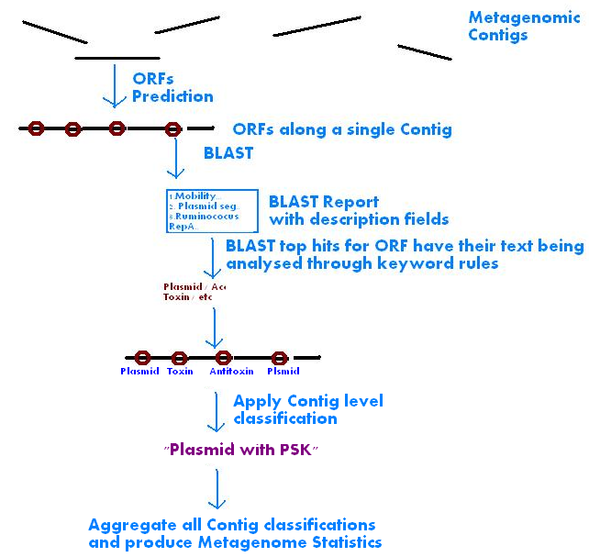
Detailed Workflow

Slide 7
ORF Classification Rules Syntax
Keyword rules are declared with the keyword AnnotateORF followed by the Classification name, “IF” and a logic expression in which the (boolean) variables are text keywords and the logic operators are of the set: AND, OR, NOT. The usage of parenthesis is also allowed.
If a text keyword appears at least once in a given description field of a certain BLAST hit, it would be replaced by a boolean true in the evaluation of the logic expression.
A special character, ~ (tilde) may be used as a wildcard in the beginning, middle or end of a text keyword.

Slide 8
ORF Classification Rules Syntax (Example)
Given the following Classification Rule: AnnotateORF Plasmid IF Plasmid OR Mob~ OR Rep~
AnnotateORF Antibiotics IF (RESISTANCE or MULTIDRUG or LACTAMASE or EFFLUX or REDUCTASE or DIHYDROFOLATE or TETRACYCLINE or PYROPHOSPHATE or AMINOGLYCOSIDE or CHLORAMPHENICOL or ACETYLTRANSFERASE or UNDECAPRENYL or PHOSPHOTRANSFERASE or DIHYDROPTEROATE or UNDECAPRENYL or PENICILLIN or STREPTOMYCIN or ACRIFLAVINE or MULTIDRUG or DIMETHYLADENOSINE or BICYCLOMYCIN or MACROLIDE or PENICILLIN or UNDECAPRENOL)
Whilst the following hit description would be classified as Plasmid: “MobA protein subunit A.”
The following hit description would not get a Plasmid classification: “Protoplast elongation factor EC 2.112”

Slide 9
Contig Classification Rules Syntax
Contig classification rules are declared with the keyword ClassifyContig followed by the Classification name, “IF” and a logic expression in which the (boolean) variables are ORF classifications and the logic operators are of the set: AND, OR, NOT. The usage of parenthesis is also allowed.
If a ORF Classification is assign at least to one of the child ORFs in a given contig, it would be replaced by a boolean true in the evaluation of the logic expression for the given that contig.

Slide 10
Contig Classification Rules Syntax (Example)
Given the following Classification Rule: ClassifyContig PlasmidWithAntibiotics IF Plasmid and Antibiotics Only Contigs in which at least one ORF that is classified as Plasmid and another one is classified as Antibiotic would get the contig classification of PlasmidWithAntibiotics.

Slide 11
Results in Numbers
From our data-set, more than 78% of the contigs were classified as being plasmids.
Manual validation by skimming of random sub-sample of the automatically classified contigs showed 0 false-positive and 20% false-negatives.
Plasmids with adjacent Toxin-Antitoxin coding genes were discovered
About 1% of the Plasmid harbored antibiotic resistance coding gene

Slide 12
Conclusion
A bioinformatics pipeline was developed that enabled us to confirm that the vast majority that were isolated from the noble plasmid specific metagenomic extractions are indeed of plasmid origin.
Being a text-mining based classification tool with the ability to define custom-made classifications based on keyword rules proposes the tool as a general-purpose tool for use in other metagenomic projects that where classification of contigs based on tailor-made categories is in need.

Slide 13
Real World Script Example
MaxHitstoConsider=20 MinPositiveHitsPercent=15 ContigFileName=/home/user2/hess/hess_contigs.fa RunBLAST=local e_value=0.00001 BLASTReport=/home/user2/mc_baker/BlastReports/hess_combined_blasts/combined_hess_blast program=blastp db=/db/ncbi/nr.fa AnnotateDescription Plasmid_1=(plasmid~) AnnotateDescription Plasmid_maybe= (stba or stbb or stbc or relaxase or inc or tra~ or mob~ or rep~) and not (mobilis or transd~ or transa~ or transc~ or transport~ or transk~ or transl~ or transm~ or transg~ or reptile or repe~ or repai~ or repr~ or ~transferase or transferases or transa~ or transporter or transpeptidase or transformylase or tractu~ or transthy~ or cis\-trans~ or Mobiluncus) AnnotateDescription ARDB=(RESISTANCE or MULTIDRUG or LACTAMASE or EFFLUX or REDUCTASE or DIHYDROFOLATE or TETRACYCLINE or PYROPHOSPHATE or AMINOGLYCOSIDE or CHLORAMPHENICOL or ACETYLTRANSFERASE or UNDECAPRENYL or PHOSPHOTRANSFERASE or DIHYDROPTEROATE or UNDECAPRENYL or PENICILLIN or STREPTOMYCIN or ACRIFLAVINE or MULTIDRUG or DIMETHYLADENOSINE or BICYCLOMYCIN or MACROLIDE or PENICILLIN or UNDECAPRENOL) AnnotateDescription CRISPR_1=(crispr or cas~) and not (cass~ or cassette or casei or caspase) AnnotateDescription Toxin_1=(toxin~) and not (~antitoxin) AnnotateDescription AntiToxin_1=(~antitoxin) AnnotateDescription Intron_1= (intron) AnnotateDescription Cazy_1= (Glycoside~ or Glycosyl~ or Polysaccharide~ or Carbohydrate) ClassifyContig Plasmid IF Plasmid_1 ClassifyContig Maybe_Plasmid IF Plasmid_maybe ClassifyContig AntiResist IF ARDB ClassifyContig CRISPR IF CRISPR_1 ClassifyContig AntiToxin IF AntiToxin_1 ClassifyContig Toxin IF Toxin_1 ClassifyContig Intron IF Intron_1 ClassifyContig Cazy IF Cazy_1

Slide 14
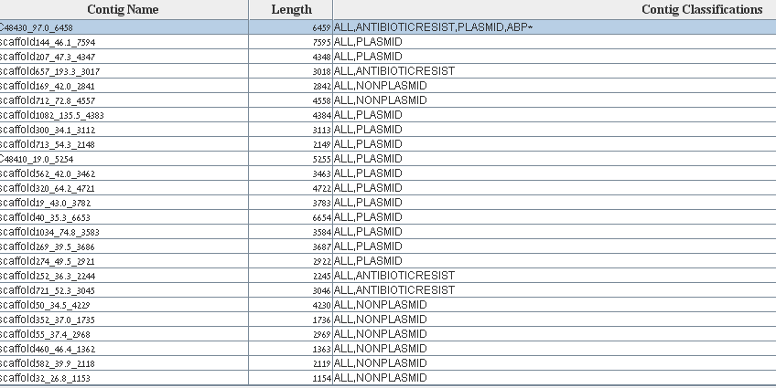
Screenshot #1 – Contigs List

Slide 15
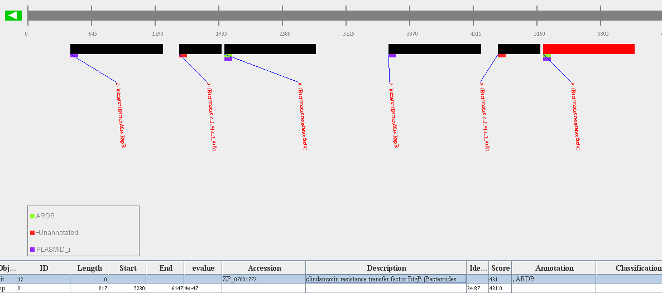
Screenshot #2 – Contig View

Slide 16
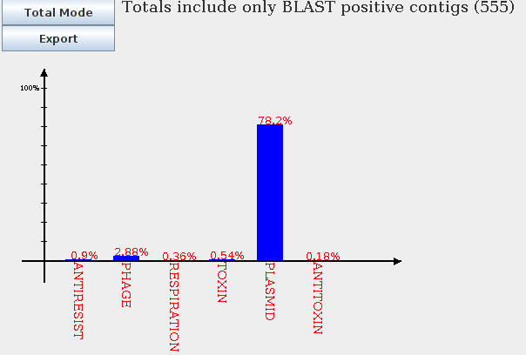
Screenshot #3 – Classification Totals

